Slide 1
Developing a computer game that utilises 3-D graphics to be as enjoyable and engaging as possible so as to increase the average user's play time

Slide 2




Learning the skills
Notes:
Free open source cross-platform software.

Slide 3
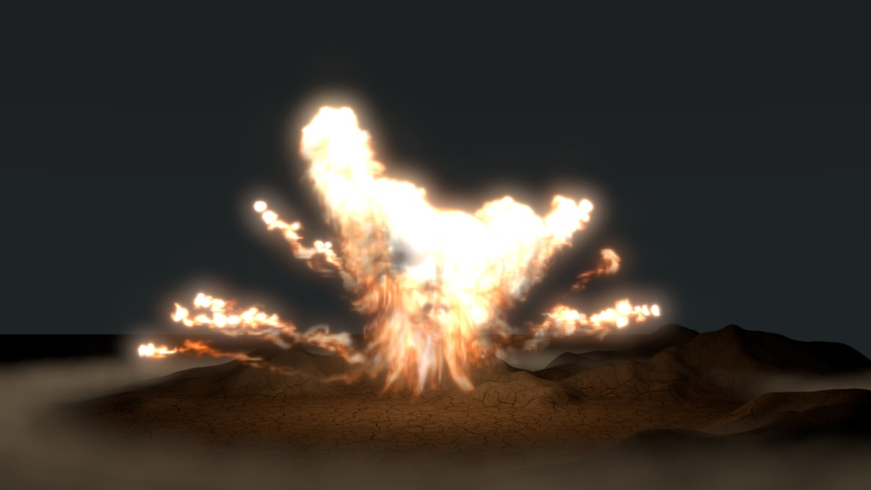
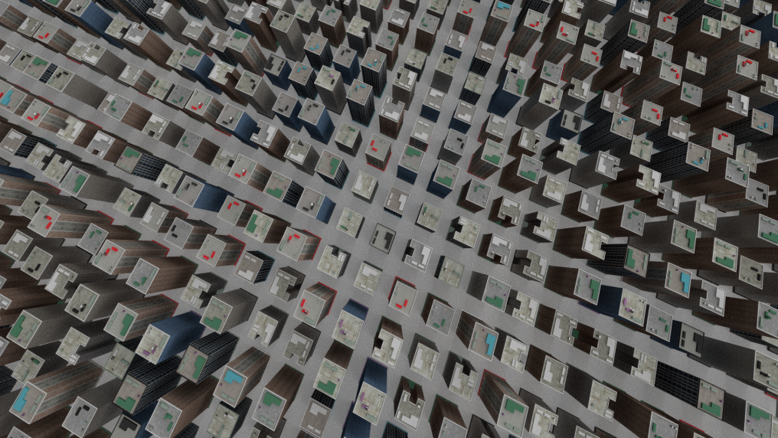
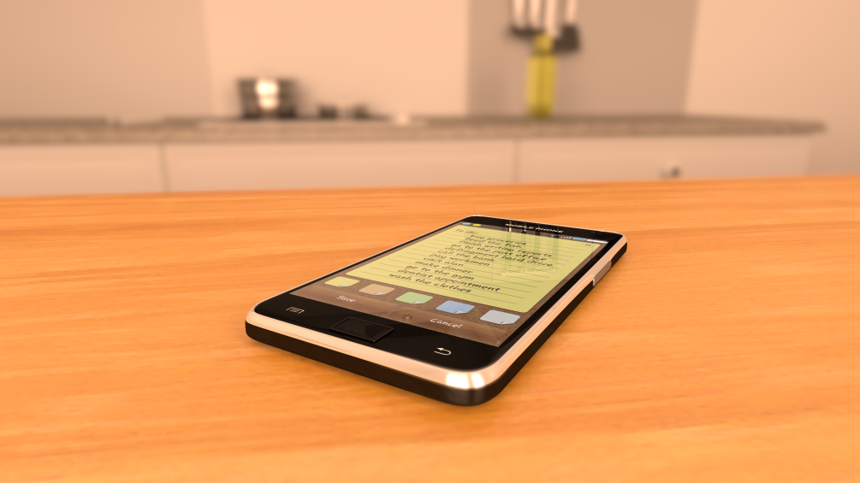
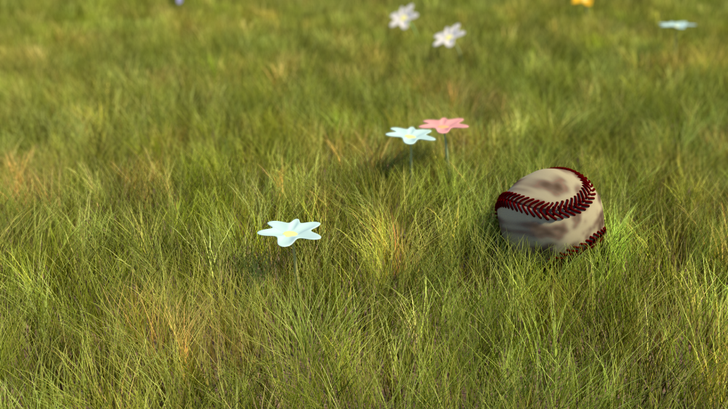

Notes:
I chose the Blender Game Engine for the creation of my game because I already had experience with Blender for creating still images and very basic animations.
Anything other than modelling was very different in the game engine: post-processing effects were very limited and reduced performance; particle systems couldn’t be used and the same effect had to be achieved with Python code; materials were done completely differently and were much more limited. I also chose Blender because it costs nothing and I like to support open source software.

Slide 4
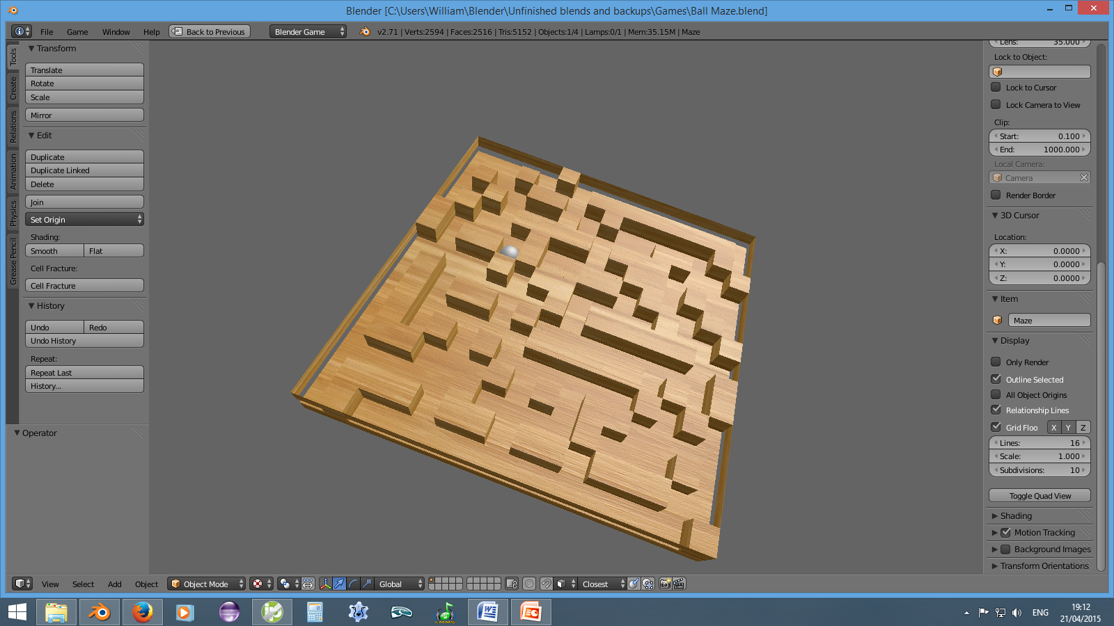
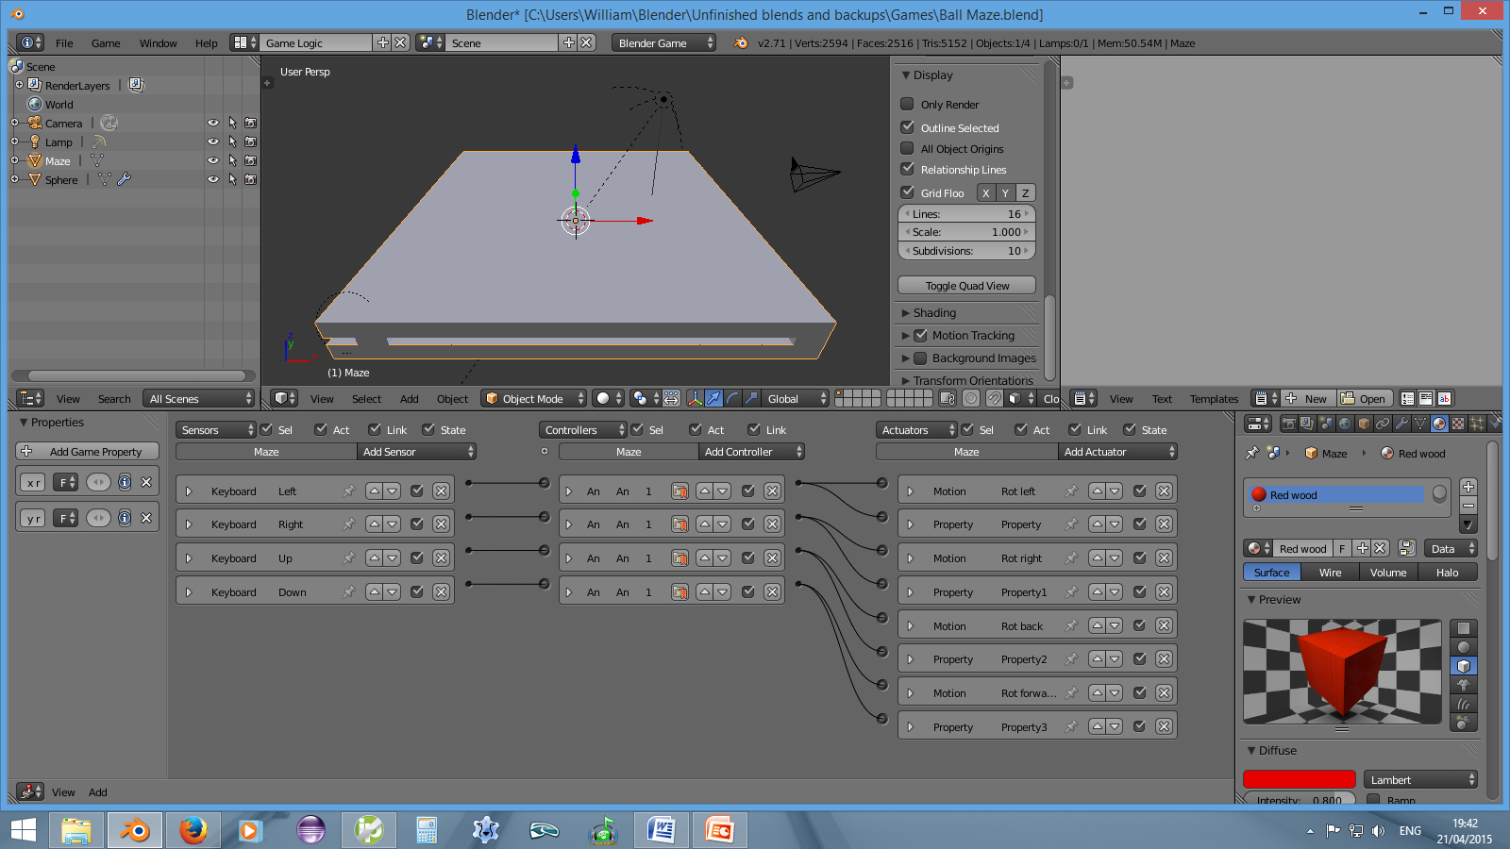
Notes:
The first 3-D game I made was this maze puzzle where you could tilt the board in order to move the ball around the maze; the physics engine handled this aspect and the only logic was to move the tilt the board when the arrow keys were pressed – no code was required. The idea for this came from a video tutorial showing a very simple version where the player had to tilt the board to get the ball to fall through a hole. From this I also learnt a considerable amount about materials in the game engine.

Slide 5
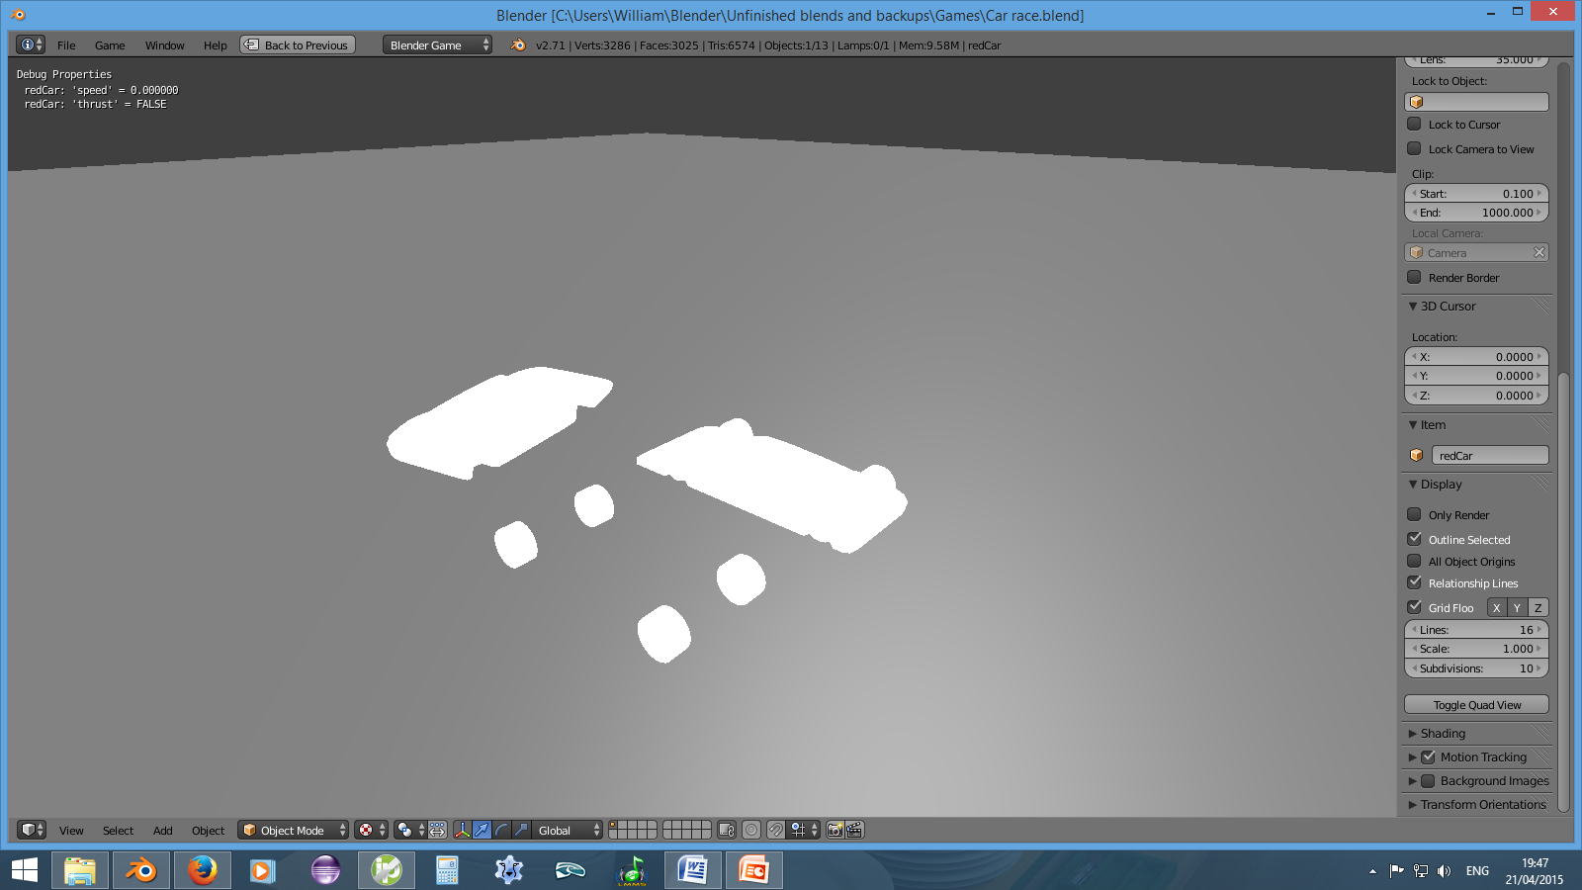
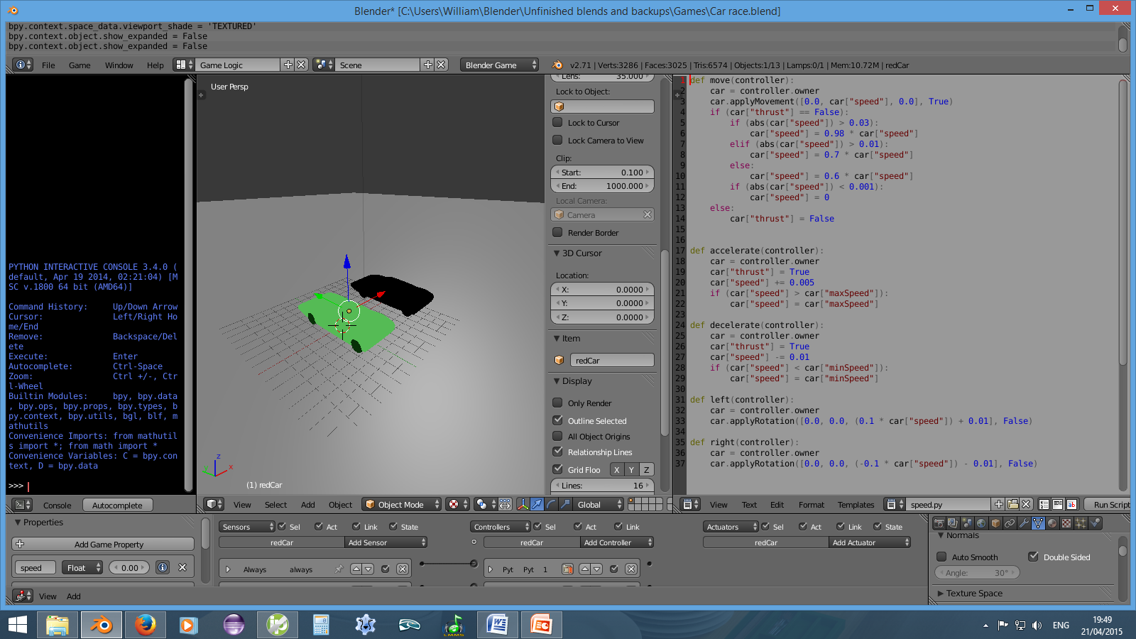
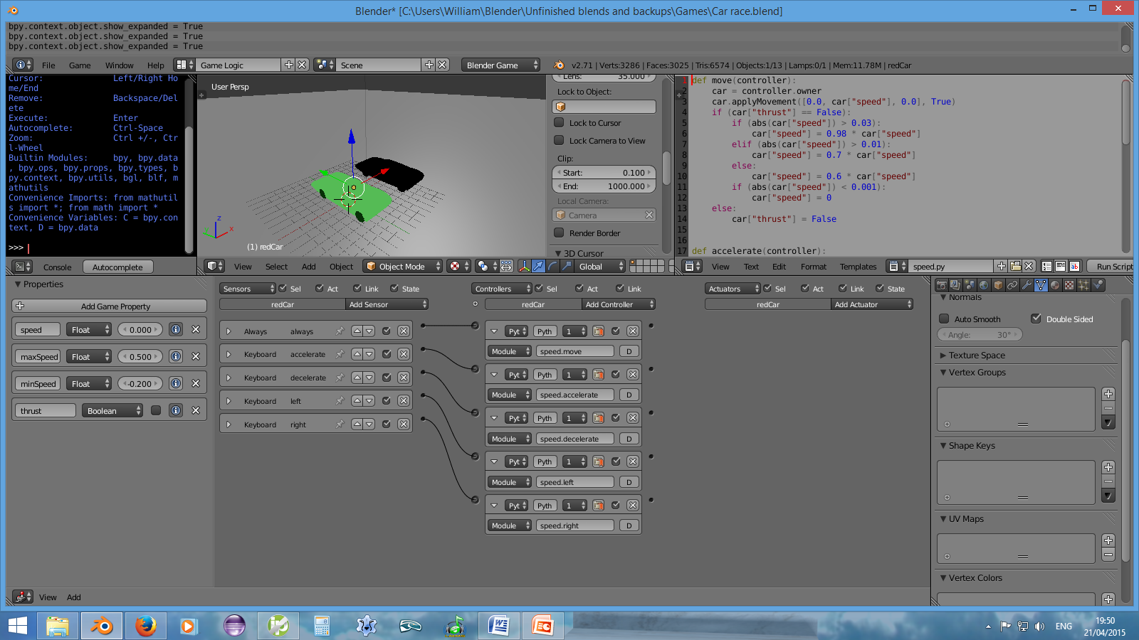
Notes:
This was the next game I had some sort of attempt at; this time all of the actions were handled in python code; logic bricks were just used to execute different sections of code when keys were pressed or when a frame was rendered. One of the cars was controllable and handled in a somewhat convincing way. The physics engine also allowed the cars to interact when they collided.

Slide 6
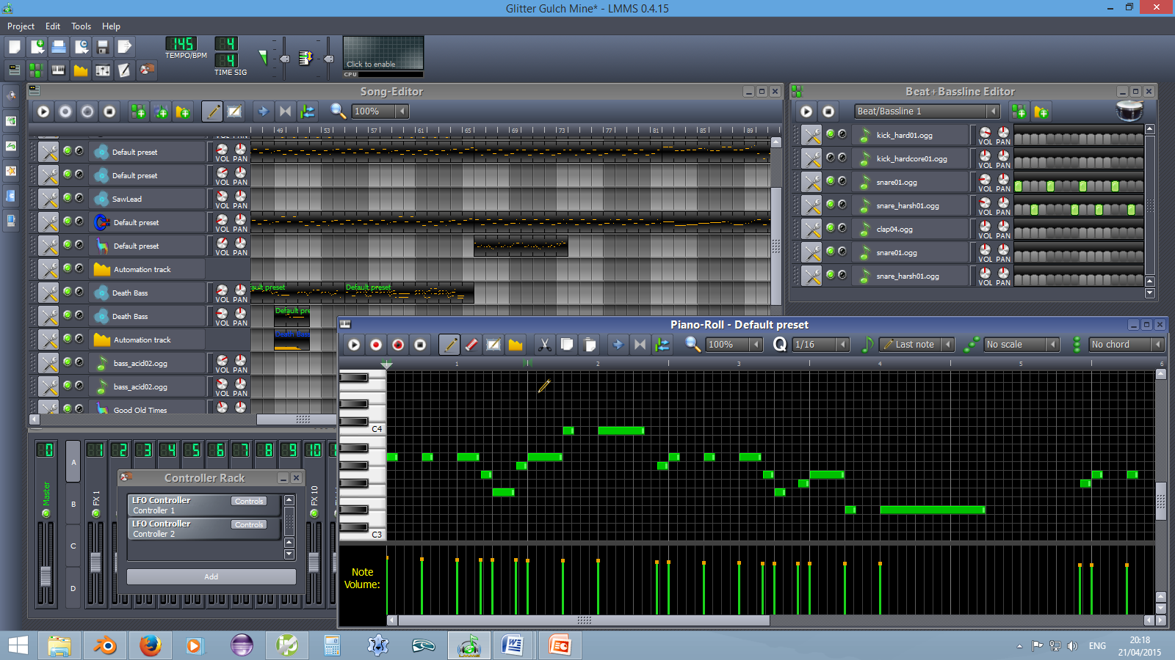
LMMS
Notes:
I also had some experience with LMMS, but not for making original tunes or sound effects. Again I chose this because it is free and open source.

Slide 7
Feasibility
“open world action games with a lot of production value, and you do need a team of 400 to 600 people, that's a lot, and next-gen is increasing this.”
– Pauline Jacquey, Ubisoft Managing Director
“some foreign games can take over five years from initial proposal to the actual product release.”
– Masahiro Sakurai, creator and director of the Kirby and Super Smash Bros. series
Notes:
No character designing, large numbers of environments or storytelling in order to have replay value.

Slide 8
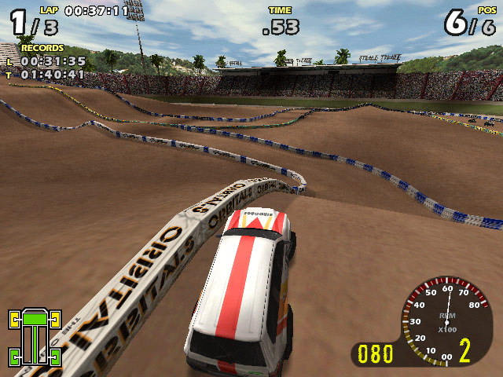
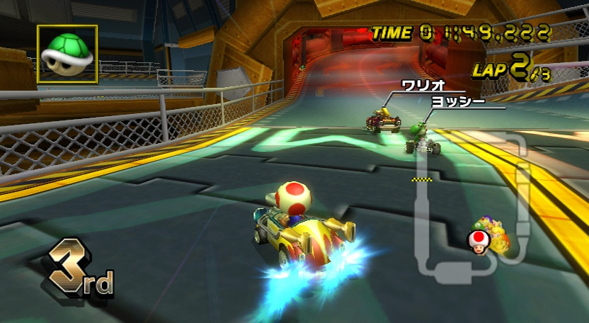
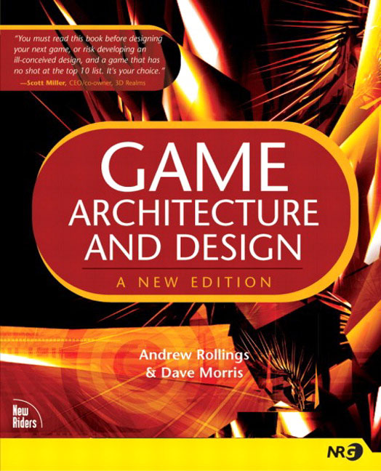
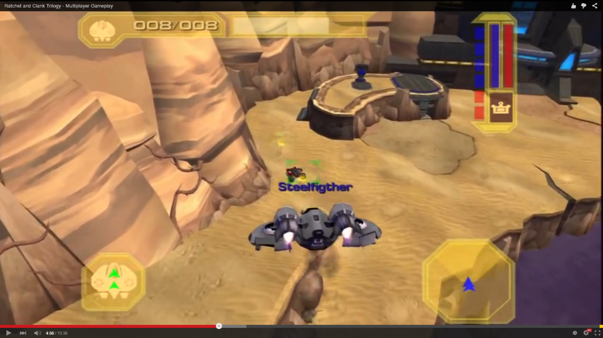
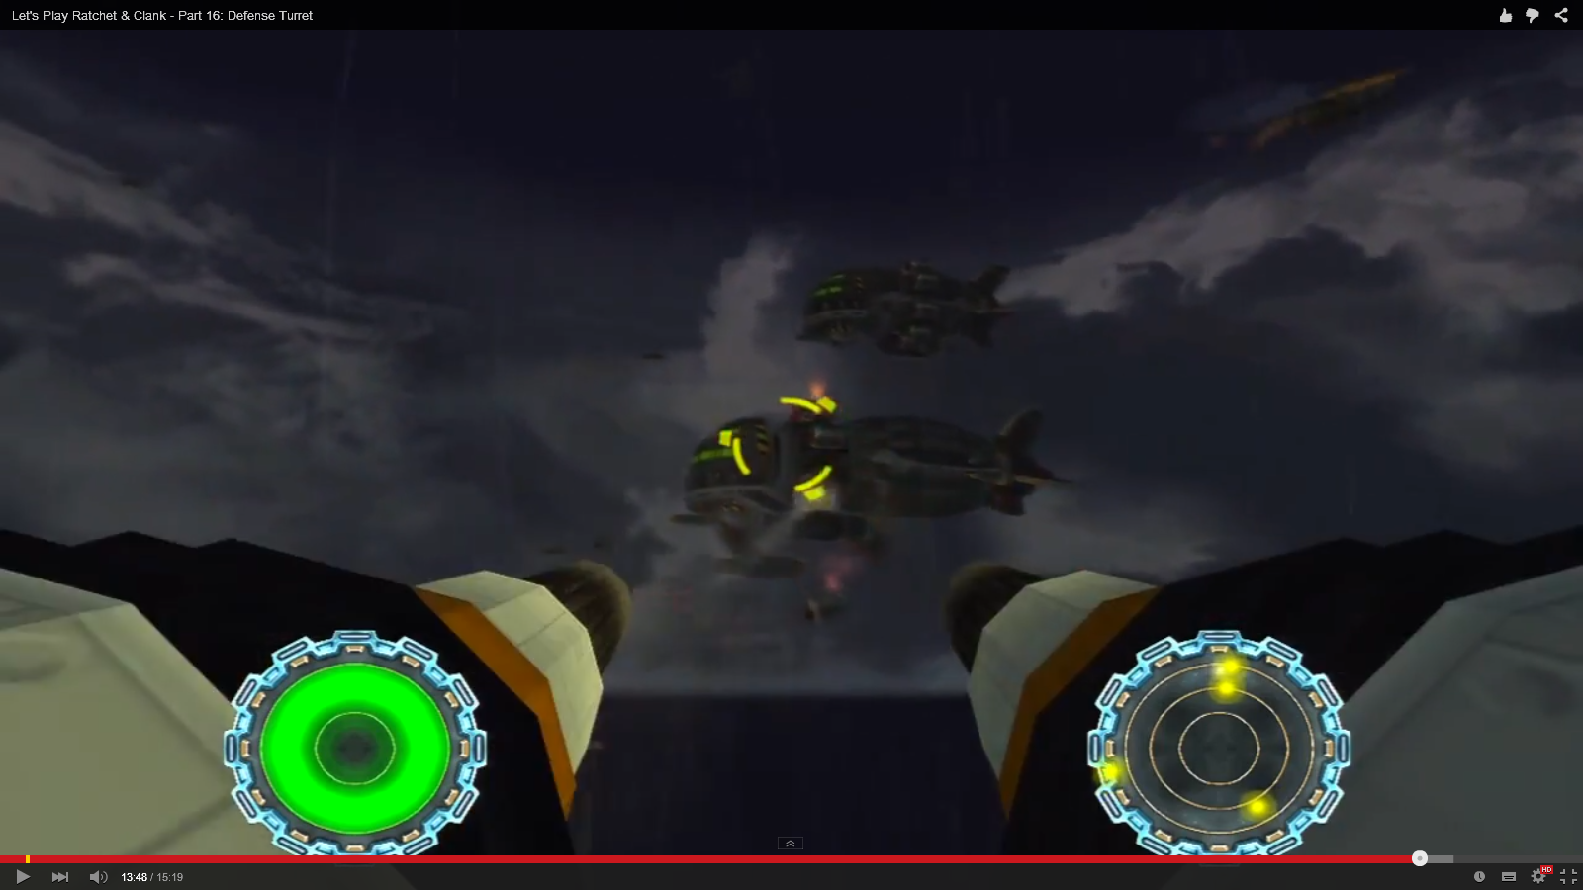
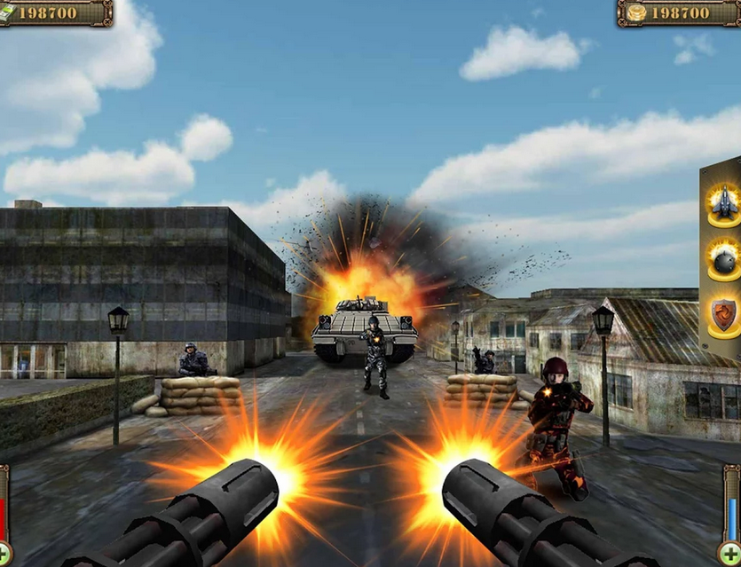
“In order to make a great game, you must first find it fun yourself, and hopefully this can be used to build something that appeals to others as well. But in the end, the spark must come from within.”
– Richard Rouse III
Notes:
After suitably narrowing down the possibilities I took the advice to be creative for the time being and judge feasibility later. I thought of doing a racing game and a turret defence game. A racing game turned out not to be feasible because I would either need online multiplayer or AI. Turret defence was feasible, but I preferred the spaceship endless running idea. Idea for game destroying bases from an aerial vehicle, but my experience with such things was not so fun and the controls are awkward (not making up for the realism).

Slide 9
“...successful games can be useful, not for cloning, but for analysis. As game designers, we can look at the games that have come out previously, that we have enjoyed in years past, and try to determine a set of directives that explain what compelled us to try those games in the first place, and why they held our interest once we started playing them.”
– Richard Rouse III

Slide 10
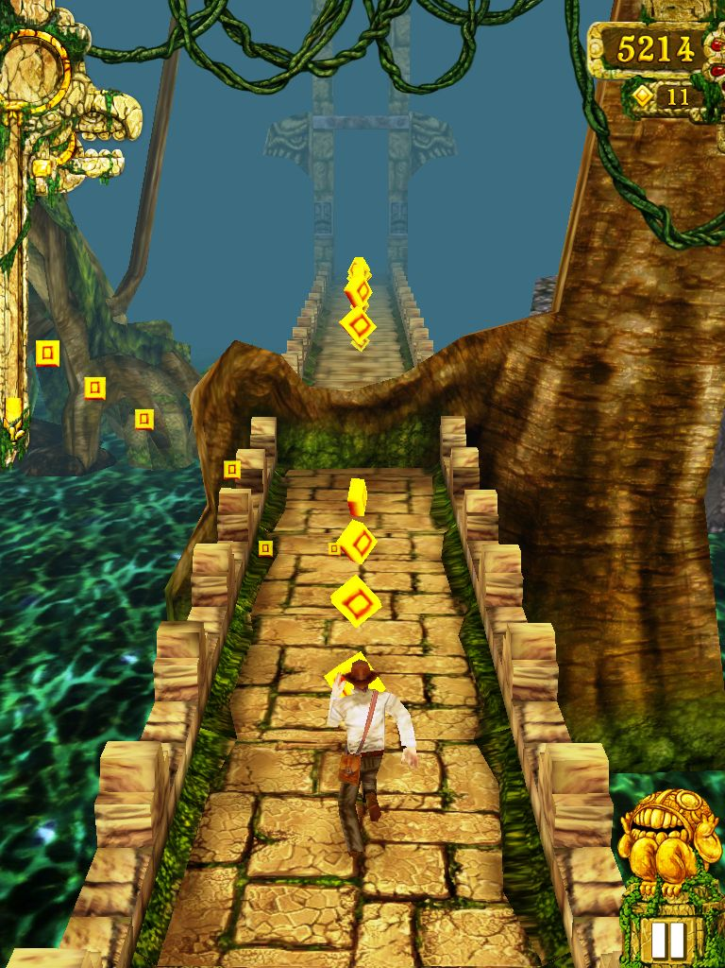
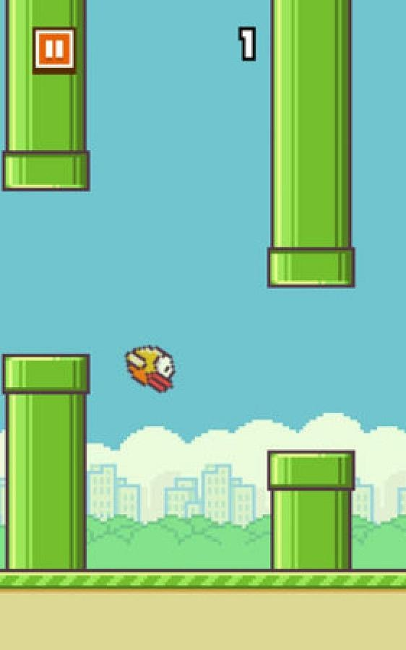
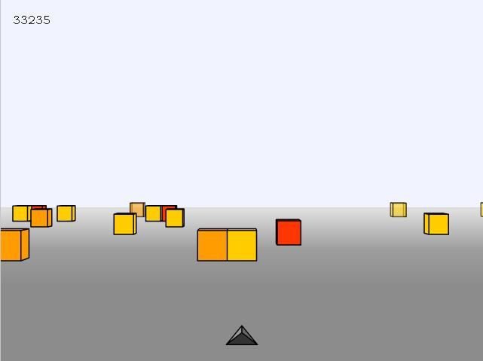
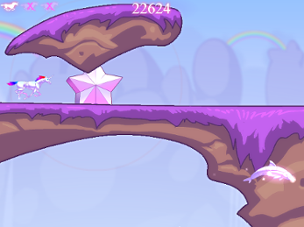
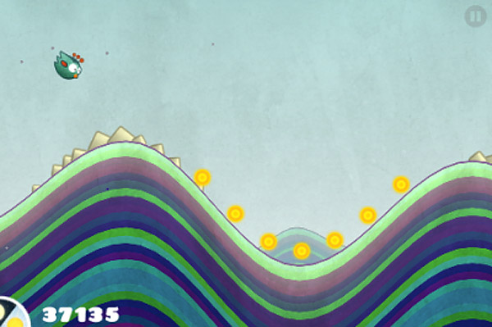
Notes:
Evidence of the success of endless running games, not only on mobiles and tablets but on computers as well. The preponderance of these are almost solely controlled in one dimension and I thought that a game fully extending this concept into two dimensions had the potential to be even more entertaining. Also, these tend to focus on dodging and perhaps collecting, but I thought shooting would be more active engagement.

Slide 11
Development
“The closest thing game development has to a reliable system for developing an original game is to get some small part of the gameplay working first, before moving ahead to build the rest of the game. This may be called a prototype, a demo, a proof-of-concept, a level, or simply the current build of the game.”
– Richard Rouse III

Slide 12
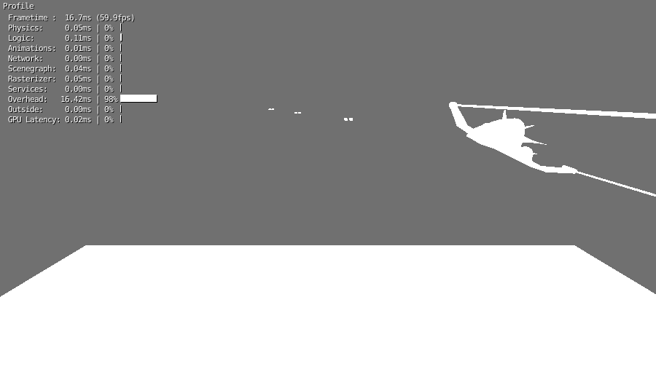
Primary Features
Notes:
The primary features for the game were to control the spaceship in two dimensions, to face oncoming asteroids which dealt damage on impact and to be able to destroy asteroids by shooting them.

Slide 13
“You don’t have to be a slave to the “Wow” factor. There is another approach to game development, which is simply to concentrate on the gameplay first, spending many hours balancing and perfecting the interactions between tokens.”
– Andrew Rollings and Dave Morris

Slide 14
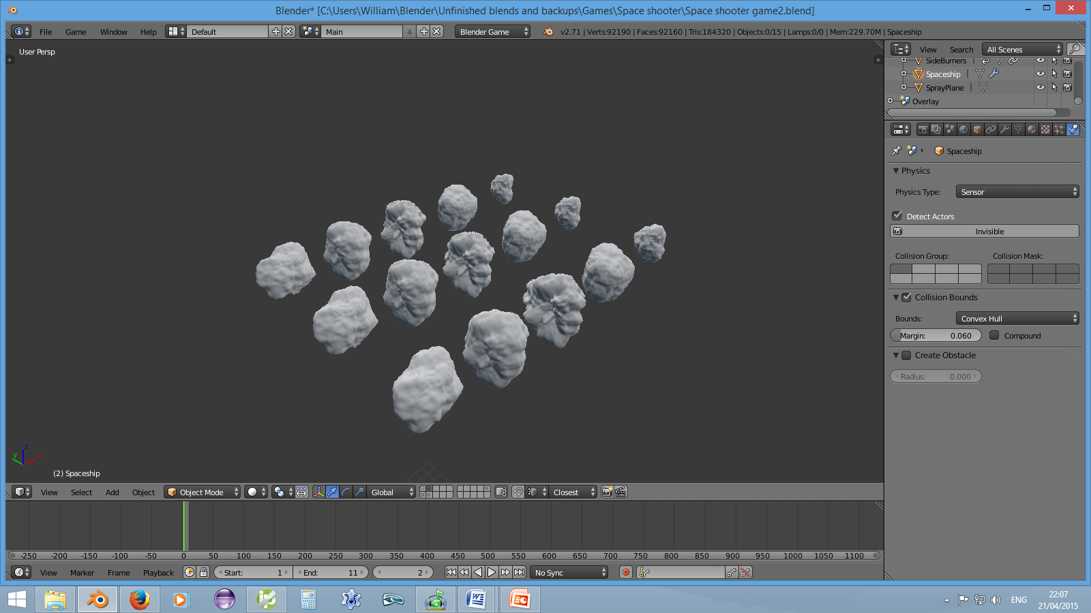
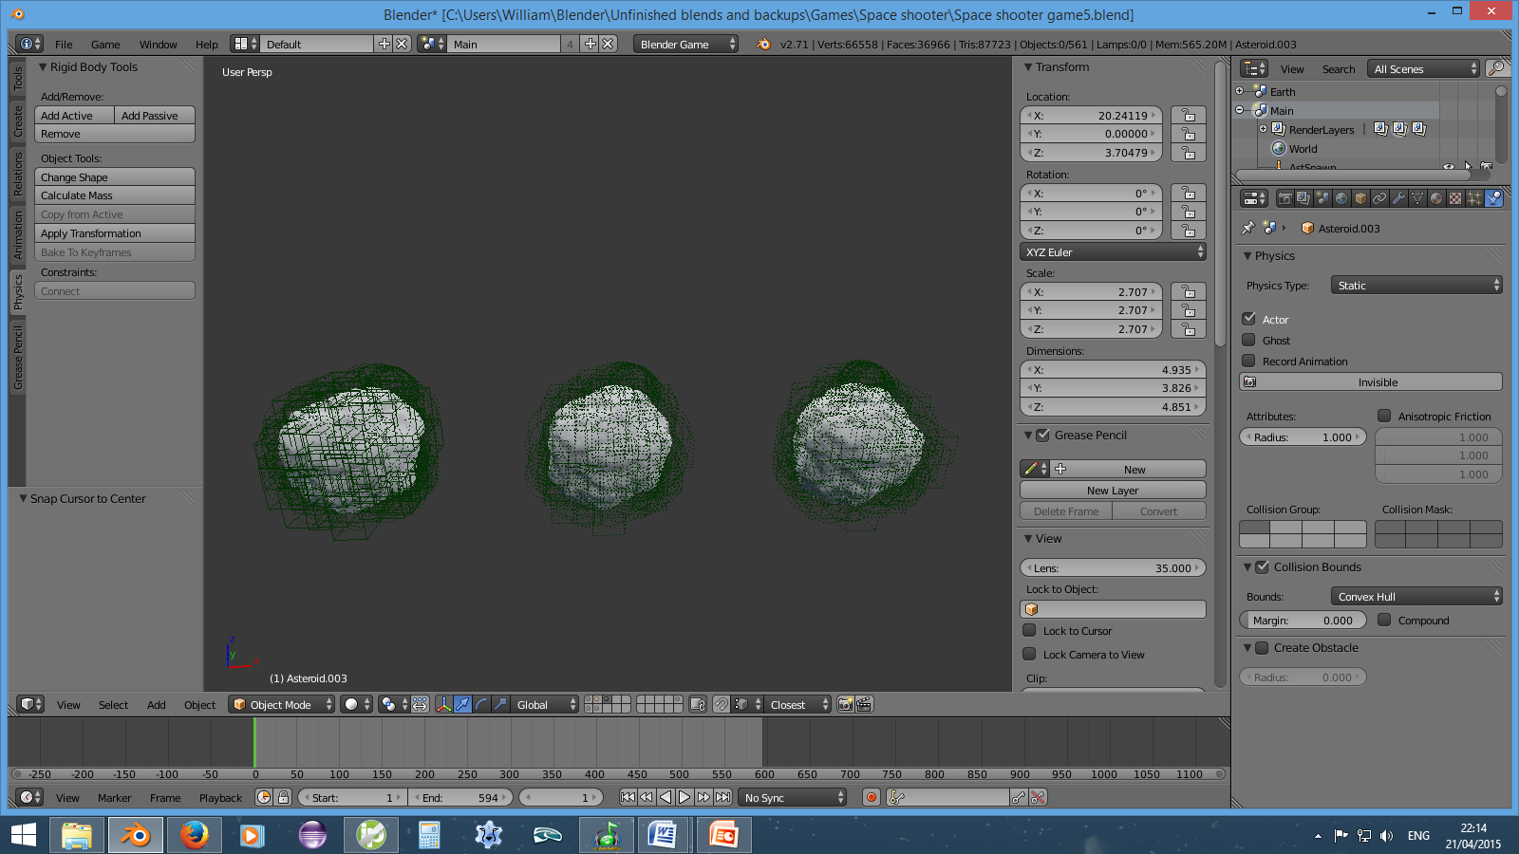
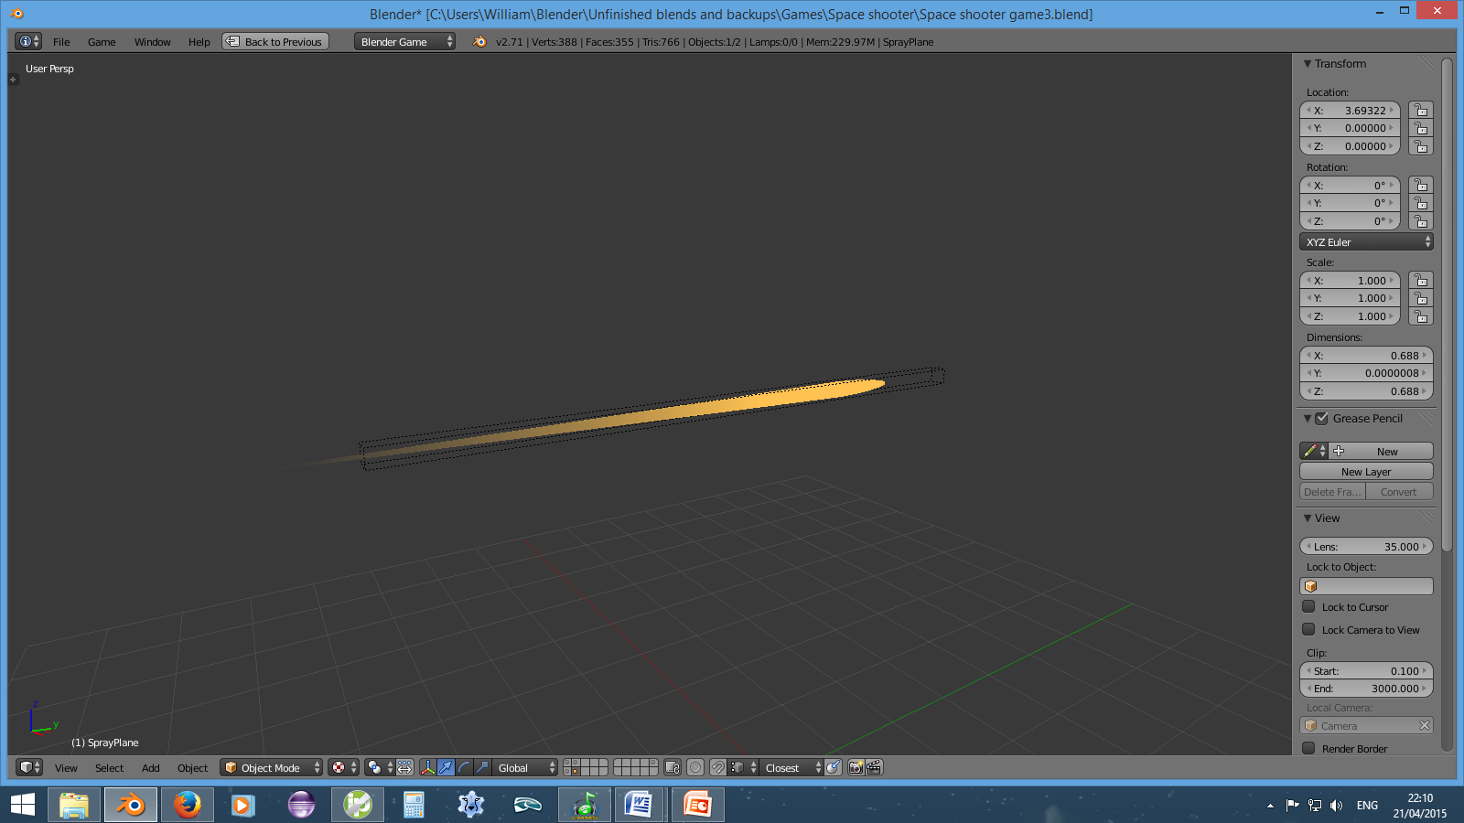
Notes:
Objects stored on separate layers for accessing by the code and keeping hidden the remainder of the time. The bullet’s shape was designed to imply motion blur and its lack of solidity (concentrated energy in sci-fi terms perhaps).

Slide 15
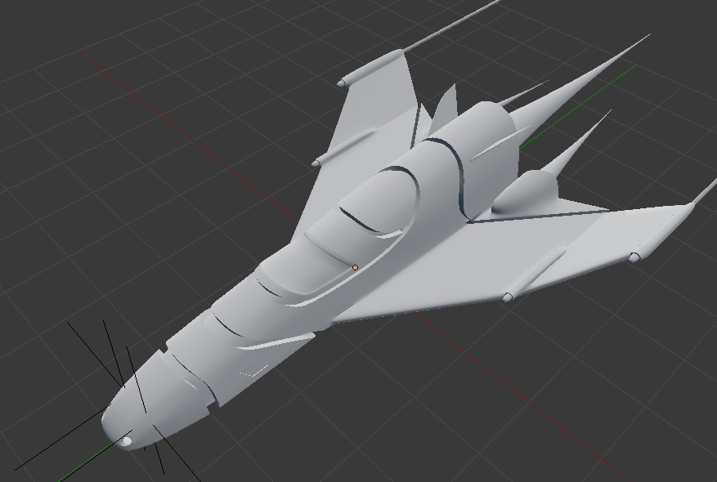
Graphical Improvements

Slide 16
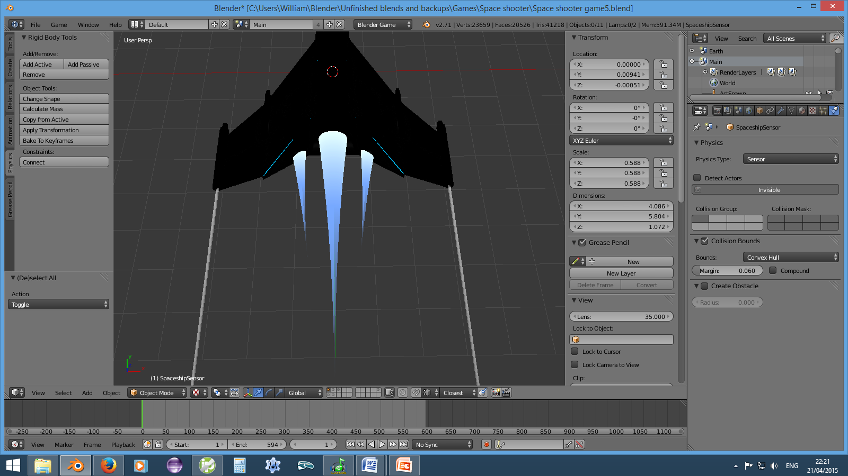
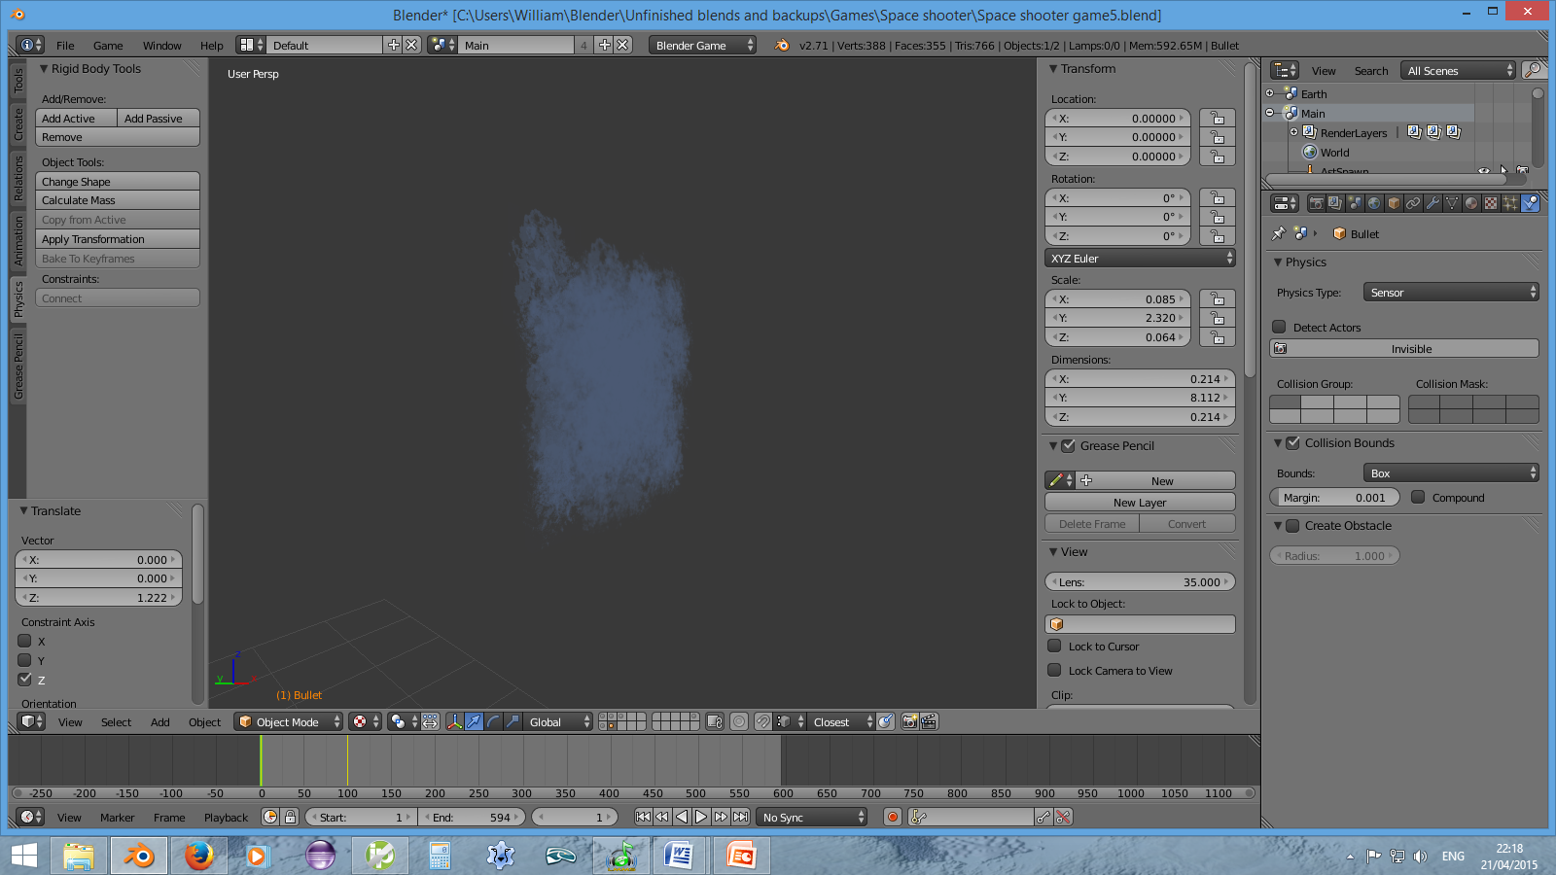
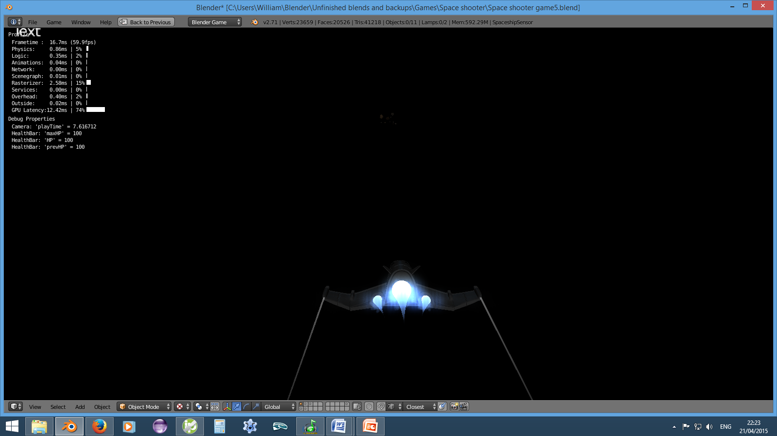
Notes:
Alternative method of effects that I am used to; semi-transparent squares are added and removed in quick succession and the flames are semi-transparent objects with a looping animation of fluctuating opacity. A bloom filter extends the light beyond the boundaries of the objects and somewhat emulates the objects casting light onto other surfaces.

Slide 17
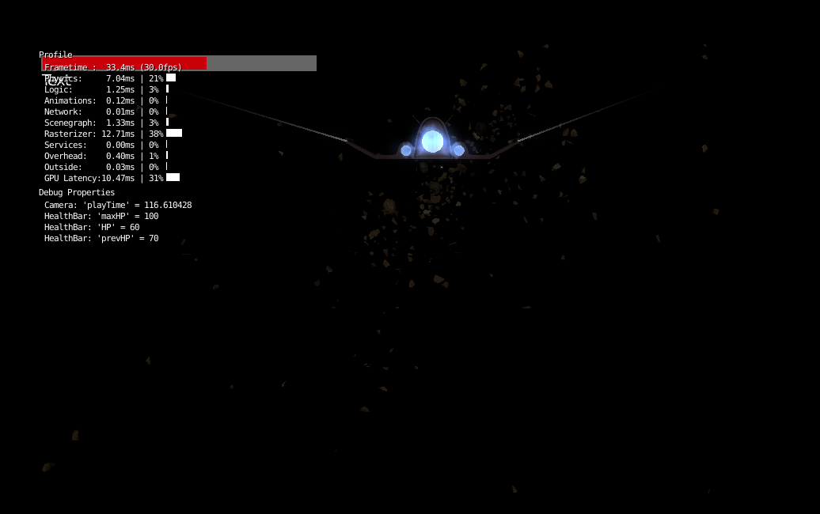
Notes:
Asteroids break into fragments when shot. The fragments could get confused for smaller asteroids and caused significant frame rate reductions. Therefore, I made the fragments shrink to nothingness over a short time period so that they would be distinguishable from asteroids or inconsequential because they disappeared before getting close, and also improving performance because exist for a shorter period.
Asteroids and the spaceship are not very visible; I recognised this as a small issue, but playtesting convinced me it was more severe than I had thought. As a result I not only added a background but changed the lighting for the sacrifice of realism.

Slide 18
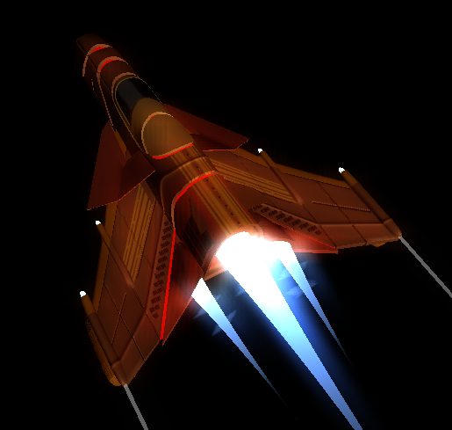
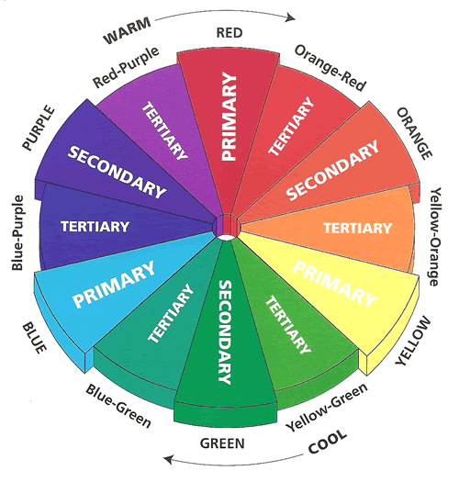
Notes:
Spaceship has analogous colours that complement the blue flames. The spaceship is also much more visible than before. The model also became more detailed. The barrels under the wings were to be used if I had been able to implement other weapons.

Slide 19
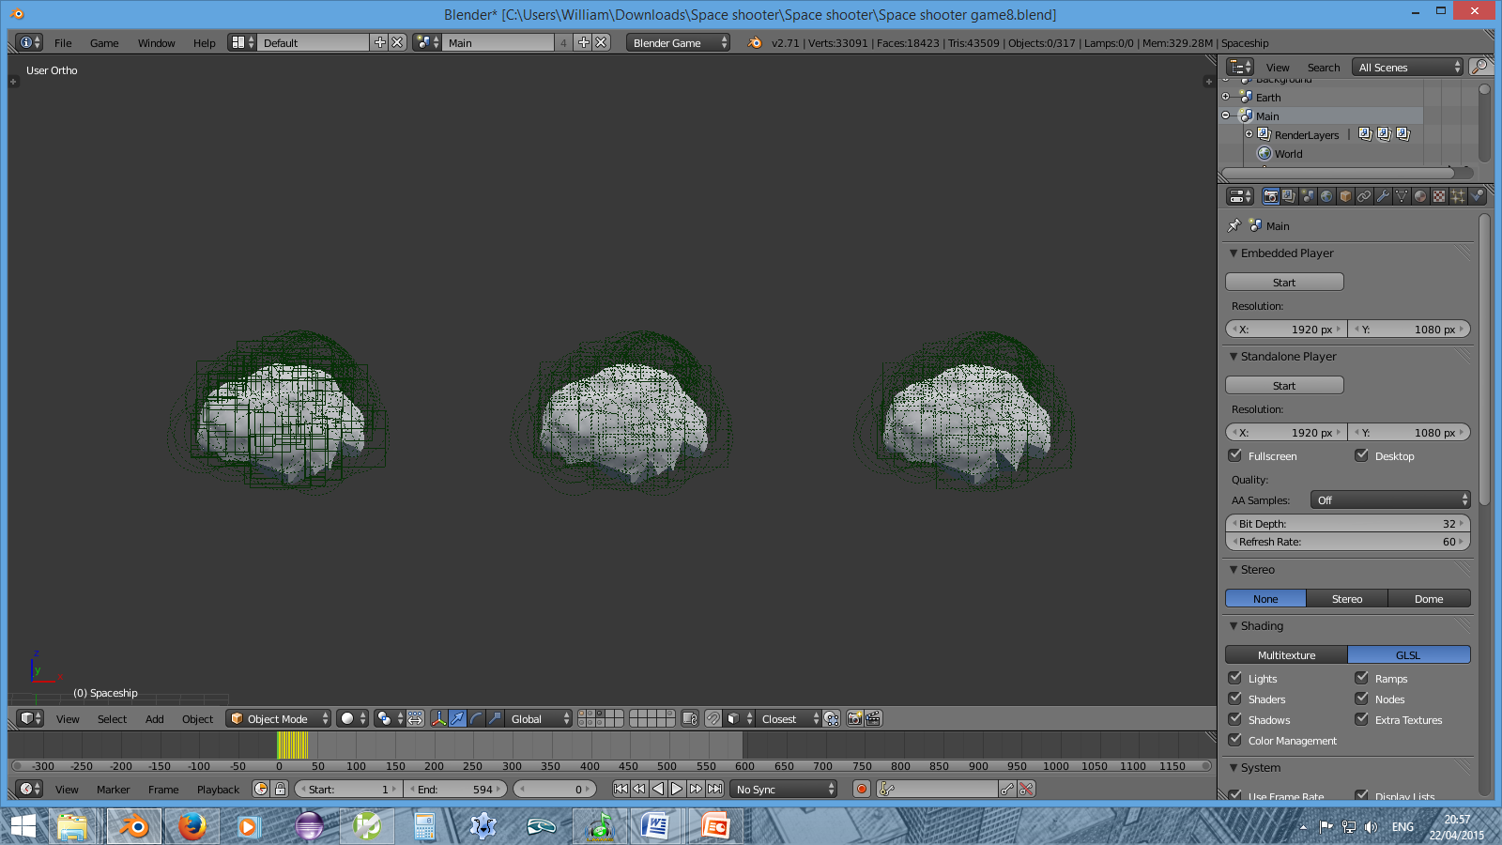
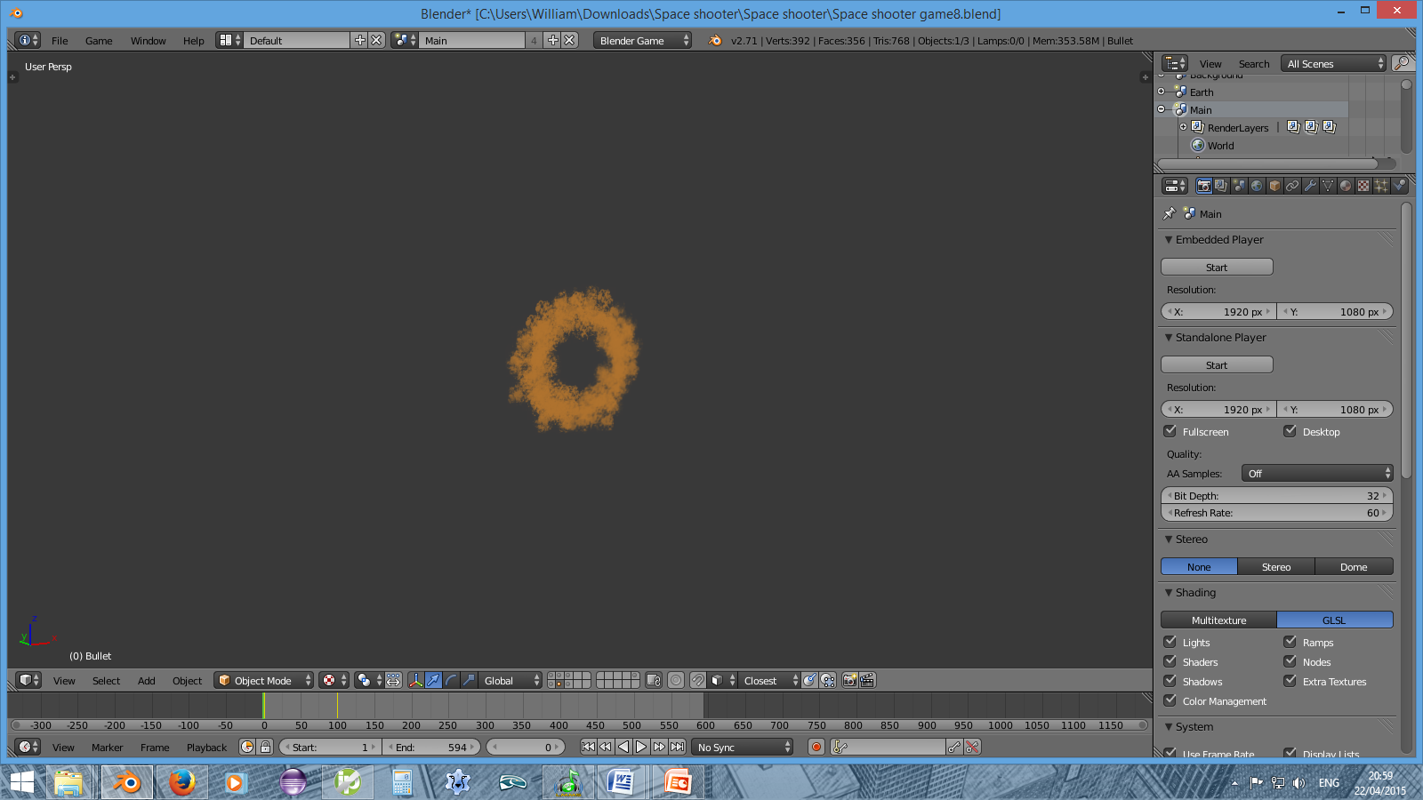
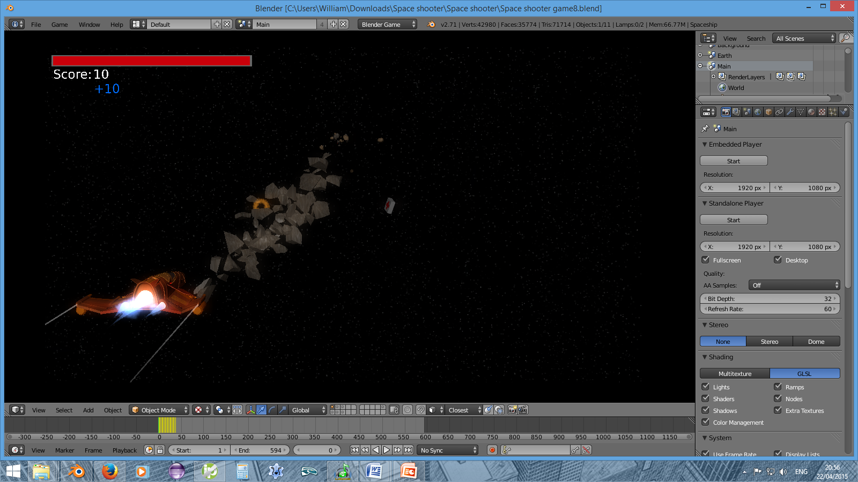
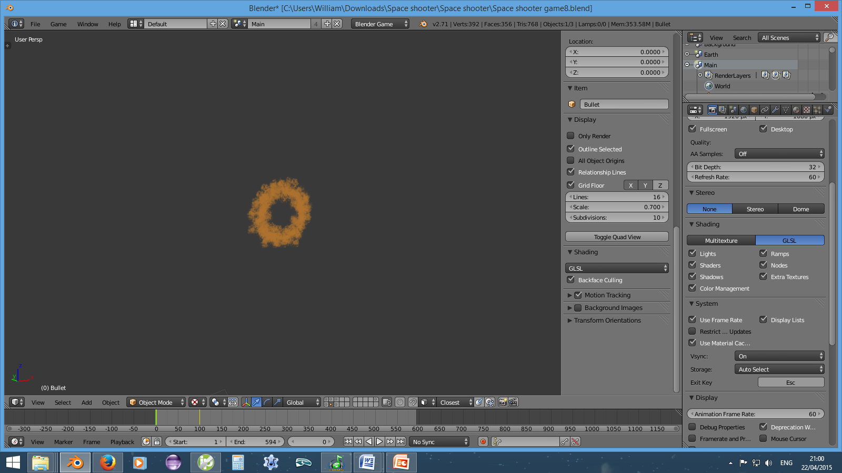
Optimisation
Notes:
For optimisation, I reduced the number of fragments formed from each asteroid and increased their size when duplicated by the code. The effect created when a bullet collided with an object was shortened and a pair of bullets only generated one. Backface culling was turned on and the spaceship model had to be modified as a result.

Slide 20
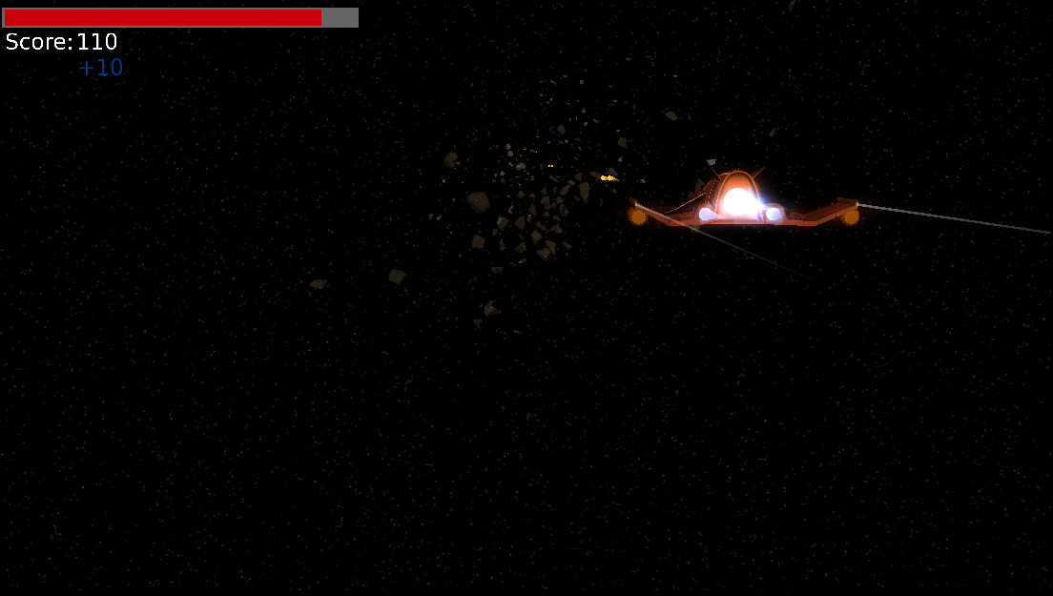
Notes:
Points added; indication of score increases so that the player can learn that smaller asteroids give more points. Health pickups were added to give the game more variation and as reason not to shoot constantly/recklessly. The spaceship was also made to flash green to indicate health gained and red to indicate damage taken.

Slide 21
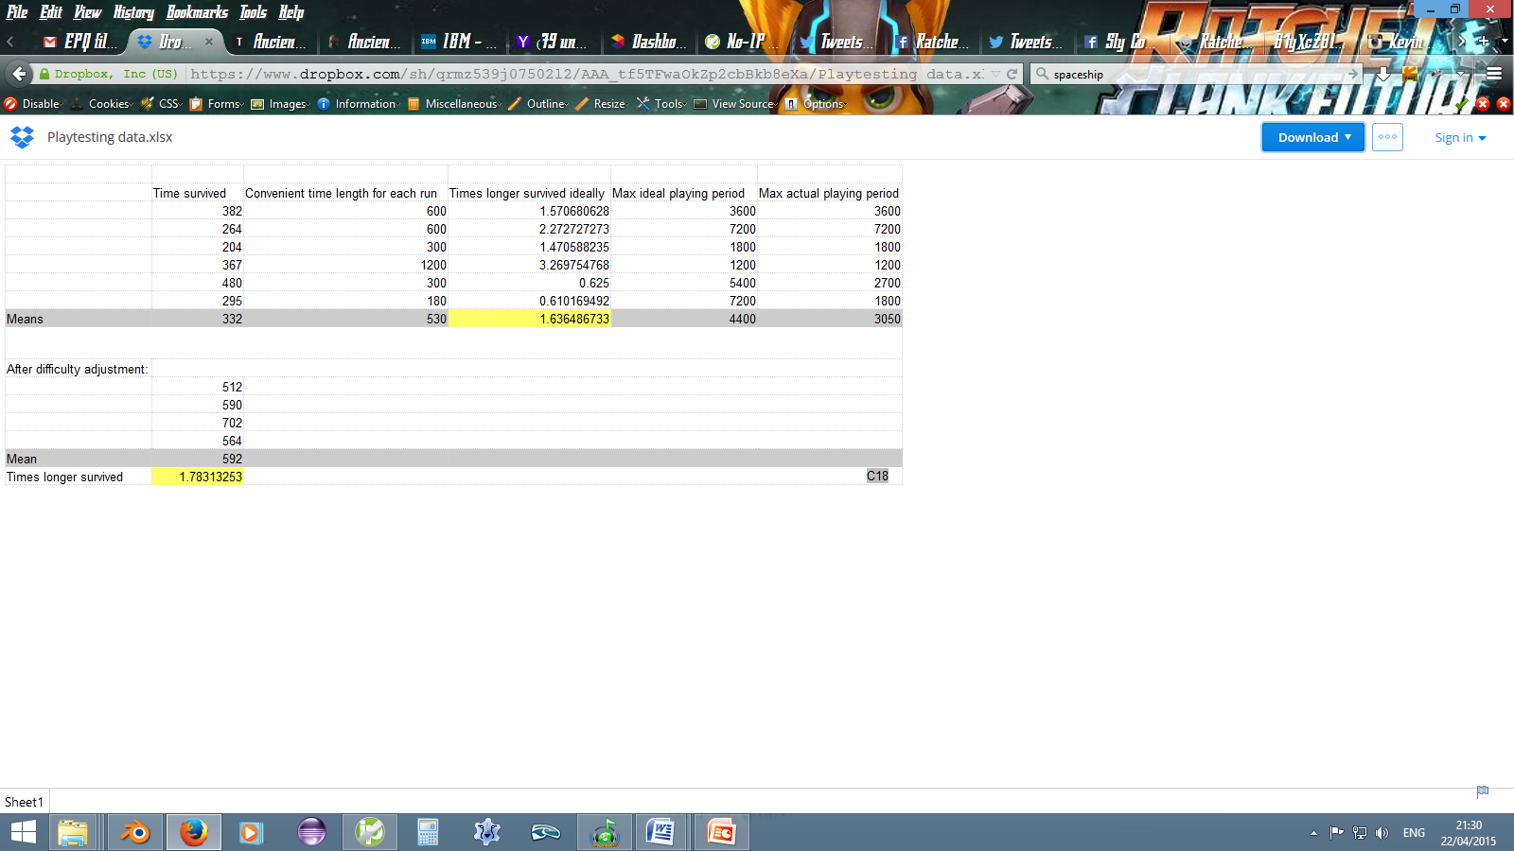
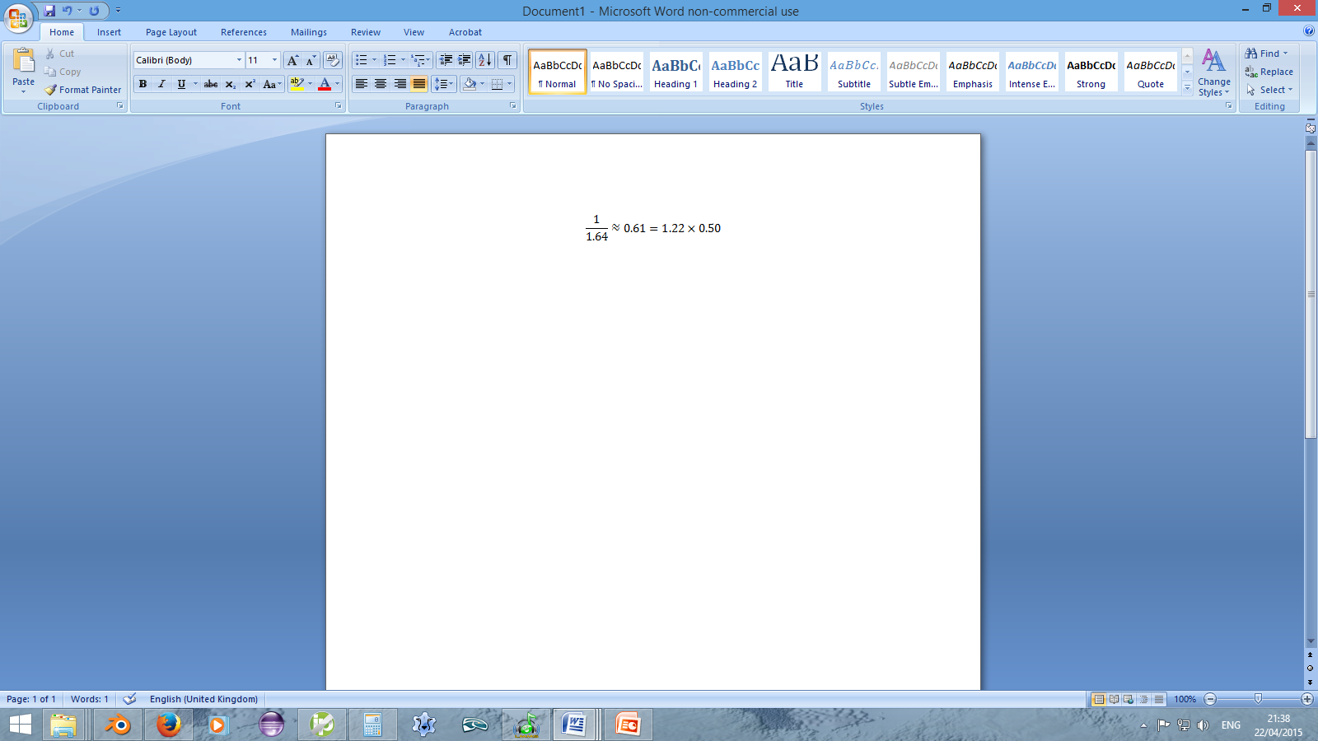
Quantitative Analysis
Assuming the overall difficulty of the game would not be affected, would you prefer damage to be less avoidable but in smaller amounts, or more avoidable but in larger amounts?
Notes:
5/6 preferred damage to be more avoidable but in larger amounts. Therefore, damage and healing was multiplied by 1.22 and the acceleration of the asteroids was reduced to 50% of what it was.

Slide 22
Improvements
Pausing
Saving scores
More pickup items; speed boosts, shields, other weapons
Limited ammunition regeneration or pickups
Introduction/Instructions/Tutorial
Accumulating points/credits over all plays in order to purchase upgrades.
Notes:
Personally, I’m not too keen on the last suggestion, but having seen it in other games of the genre (Temple run), I decided to ask the playtesters what they thought of it and 8 out of 10 were in favour.

